Slide 1
Computer Organization and Architecture
Lecture12 Multi-Cycle CPU

Slide 2
Today’s Topic
00
01. Introduction & Recap
02. Analyze the Single Cycle Microprocessor
03. Construct a Multi-Cycle Datapath
04. More details of the Multi-Cycle Datapath
05. Control
06. Exceptions
07. Summary

Slide 3
Where are we now?
1
The Five Classic Components of a Computer
Processor
Input
Control
Memory
Datapath
Output
Today's Topic: Design a Mulyi-Cycle Processor

Slide 4
Recap: Processor Design is a Process
1.1
Bottom-up
assemble components in target technology to establish critical timing
Top-down
specify component behavior from high-level requirements
Iterative refinement
establish partial solution, expand and improve
Instruction Set
Architecture
⇒
processor
datapath
control
Reg. File
Mux
ALU
Reg
Mem
Decoder
Sequencer
Cells
Gates

Slide 5
Recap: A Single Cycle Datapath
1.2
Instruction<31:0>
nPC_sel
Instruction
Fetch Unit
Rd
Rt
<21:25>
<16:20>
<11:15>
<0:15>
RegDst
Clk
1
Mux
0
Rs
Rt
Rt
Rs
Rd
Imm16
RegWr
5
5
5
ALUctr
busA
Equal
MemWr
MemtoReg
Rw
Ra
Rb
busW
32
32 32-bit
Registers
0
32
busB
ALU
0
32
Clk
32
Mux
Mux
32
WrEn
Adr
1
1
Data In
32
imm16
Extender
Data
Memory
16
32
Clk
ALUSrc
ExtOp

Slide 6
Recap: The “Truth Table” for the Main Control
1.3
RegDst
func
ALUSrc
ALU
Control
(Local)
ALUctr
op
Main
Control
:
6
3
6
ALUop
3
op
00 0000
00 1101
10 0011
10 1011
00 0100
00 0010
R-type
ori
lw
sw
beq
jump
RegDst
1
0
0
x
x
x
ALUSrc
0
1
1
1
0
x
MemtoReg
0
0
1
x
x
x
RegWrite
1
1
1
0
0
0
MemWrite
0
0
0
1
0
0
Branch
0
0
0
0
1
0
Jump
0
0
0
0
0
1
ExtOp
x
0
1
1
x
x
ALUop (Symbolic)
“R-type”
Or
Add
Add
Subtract
xxx
ALUop <2>
1
0
0
0
0
x
ALUop <1>
0
1
0
0
0
x
ALUop <0>
0
0
0
0
1
x
Notes:
Now that we have taken care of the Local Control (ALU Control), let’s refocus our attention to the Main Controller.
The job of the Main Control is to look at the Opcode field of the instruction and generate these control signals for the datapath (RegDst, ... ExtOp) as well as the 3-bit ALUop field for the ALU Control.
Here, I have shown you the symbolic value of the ALUop field as well as the actual bit assignment.
For example here (2nd column), the R-type ALUop is encode as 100 and the Add operation (3rd column) is encoded as 000..
This is call a quote “Truth Table” unquote because if you think about it, this is like having the truth table rotates 90 degrees.
Let me show you what I mean by that.
+3 = 65 min. (Y:45)

Slide 7
Recap: PLA Implementation of the Main Control
1.4
.
.
.
.
.
.
op<5>
.
op<5>
.
op<5>
.
op<5>
.
op<5>
.
op<5>
.
<0>
<0>
<0>
<0>
<0>
op<0>
R-type
ori
lw
sw
beq
jump
RegWrite
ALUSrc
RegDst
MemtoReg
MemWrite
Branch
Jump
ExtOp
ALUop<2>
ALUop<1>
ALUop<0>
Notes:
Similarly, for ALUSrc, we need to OR the ori, load, and store terms together because we need to assert the ALUSrc signals whenever we have the Ori, load, or store instructions.
The RegDst, MemtoReg, MemWrite, Branch, and Jump signals are very simple. They don’t need to OR any product terms together because each is asserted for only one instruction.
For example, RegDst is asserted ONLY for R-type instruction and MemtoReg is asserted ONLY for load instruction.
ExtOp, on the other hand, needs to be set to 1 for both the load and store instructions so the immediate field is sign extended properly.
Therefore, we need to OR the load and store terms together to form the signal ExtOp.
Finally, we have the ALUop signals.
But clever encoding of the ALUop field, we are able to keep them simple so that no OR gates is needed.
If you don’t already know, this regular structure with an array of AND gates followed by another array of OR gates is called a Programmable Logic Array, or PLA for short.
It is one of the most common ways to implement logic function and there are a lot of CAD tools available to simplify them.
+3 = 70 min. (Y:50)

Slide 8
Recap: Systematic Generation of Control
1.5
OPcode
Control Logic / Store
(PLA, ROM)
Decode
microinstruction
Instruction
Conditions
Control
Points
Datapath
In our single-cycle processor, each instruction is realized by exactly one control command or “microinstruction”
in general, the controller is a finite state machine
microinstruction can also control sequencing (see later)

Slide 9
The Big Picture: Where are We Now?
1.6
The Five Classic Components of a Computer
Today’s Topic: Designing the Datapath for the Multiple Clock Cycle Datapath
Processor
Input
Control
Memory
Datapath
Output

Slide 10
Today’s Topic
00
01. Introduction & Recap
02. Analyze the Single Cycle Microprocessor
03. Construct a Multi-Cycle Datapath
04. More details of the Multi-Cycle Datapath
05. Control
06. Exceptions
07. Summary

Slide 11
Abstract View of our single cycle processor
x = 1011000
2.1
Main
Control
op
ALU
control
fun
ALUSrc
Equal
ExtOp
MemWr
MemWr
MemRd
RegWr
nPC_sel
ALUctr
RegDst
Reg.
Wrt
Register
Fetch
Ext
ALU
Mem
Access
PC
Next PC
Instruction
Fetch
Result Store
Data
Mem
looks like a FSM with PC as state

Slide 12
What’s wrong with our CPI=1 processor?
2.2
Arithmetic & Logical
PC
Inst Memory
Reg File
mux
ALU
mux
setup
Load
PC
Inst Memory
Reg File
mux
ALU
Data Mem
mux
setup
Critical Path
Store
PC
Inst Memory
Reg File
mux
ALU
Data Mem
Branch
PC
Inst Memory
Reg File
cmp
mux
Long Cycle Time
All instructions take as much time as the slowest
Real memory is not as nice as our idealized memory
cannot always get the job done in one (short) cycle

Slide 13
Memory Access Time
2.3
Physics => fast memories are small (large memories are slow)
question: register file vs. memory
=> Use a hierarchy of memories
Storage Array
selected word line
storage cell
address
bit line
address
decoder
sense amps
L2
Cache
mem. bus
memory
Processor
Cache
proc. bus
1 time-period
20 - 500 time-periods
2-3 time-periods

Slide 14
Reducing Cycle Time
2.4
Cut combinational dependency graph and insert register / latch
Do same work in two fast cycles, rather than one slow one
May be able to short-circuit path and remove some components for some instructions!
storage element
storage element
A cyclic
Combinational
Logic (A)
A cyclic
Combinational
Logic
⇒
storage element
Acyclic
Combinational
Logic (B)
storage element
storage element

Slide 15
Today’s Topic
00
01. Introduction & Recap
02. Analyze the Single Cycle Microprocessor
03. Construct a Multi-Cycle Datapath
04. More details of the Multi-Cycle Datapath
05. Control
06. Exceptions
07. Summary

Slide 16
Basic Limits on Cycle Time
3.1
Next address logic
PC <= branch ? PC + offset : PC + 4
Instruction Fetch
InstructionReg <= Mem[PC]
Register Access
A <= R[rs]
ALU operation
R <= A + B
Control
MemWr
MemWr
MemRd
RegWr
nPC_sel
ALUctr
RegDst
ALUSrc
ExtOp
Reg.
File
Instruction
Fetch
Operand
Fetch
Exec
Mem
Access
PC
Next PC
Result Store
Data
Mem

Slide 17
Partitioning the CPI=1 Datapath
3.2
Add registers between smallest steps
Place enables on all registers
Equal
MemWr
MemWr
MemRd
RegWr
nPC_sel
ALUSrc
RegDst
ExtOp
ALUctr
Reg.
File
Instruction
Fetch
Operand
Fetch
Exec
Mem
Access
PC
Next PC
Result Store
Data
Mem

Slide 18
Example Multicycle Datapath
3.3
Equal
MemToReg
RegWr
MemWr
RegDst
nPC_sel
MemRd
ALUctr
ALUSrc
ExtOp
E
Reg.
File
Reg
File
A
Ext
ALU
S
PC
IR
Next PC
B
Mem
Access
M
Data
Mem
Instruction
Fetch
Result Store
Operand
Fetch
Critical Path ?

Slide 19
Recall: Step-by-step Processor Design
3.3
Step 1: ISA => Logical Register Transfers
Step 2: Components of the Datapath
Step 3: RTL + Components => Datapath
Step 4: Datapath + Logical RTs => Physical RTs
Step 5: Physical RTs => Control

Slide 20
Step 4: R-rtype (add, sub, . . .)
3.4
inst Logical Register Transfers
ADDU R[rd] <– R[rs] + R[rt]; PC <– PC + 4
Logical Register Transfer
Physical Register Transfers
inst Physical Register Transfers
IR <– MEM[pc]
ADDU A<– R[rs]; B <– R[rt]
S <– A + B
R[rd] <– S; PC <– PC + 4
Time
E
Reg.
File
Reg
File
A
S
Exec
PC
IR
Next PC
Inst. Mem
B
Mem
Access
M
Data
Mem

Slide 21
Step 4: Logical immed
3.5
inst Logical Register Transfers
ORI R[rt] <– R[rs] OR ZExt(Im16); PC <– PC + 4
Logical Register Transfer
Physical Register Transfers
inst Physical Register Transfers
IR <– MEM[pc]
ORI A<– R[rs]; B <– R[rt]
S <– A or ZExt(Im16)
R[rt] <– S; PC <– PC + 4
Time
E
Reg.
File
Reg
File
A
S
Exec
PC
IR
Next PC
Inst. Mem
B
Mem
Access
M
Data
Mem

Slide 22
step 4 : Load
3.6
inst Logical Register Transfers
LW R[rt] <– MEM[R[rs] + SExt(Im16)];
PC <– PC + 4
Logical Register Transfer
Physical Register Transfers
inst Physical Register Transfers
IR <– MEM[pc]
LW A<– R[rs]; B <– R[rt]
S <– A + SExt(Im16)
M <– MEM[S]
R[rd] <– M; PC <– PC + 4
Time
E
Reg.
File
Reg
File
A
S
Exec
PC
IR
Next PC
Inst. Mem
B
Mem
Access
M
Data
Mem

Slide 23
Step 4 : Store
3.7
inst Logical Register Transfers
SW MEM[R[rs] + SExt(Im16)] <– R[rt];
PC <– PC + 4
Logical Register Transfer
Physical Register Transfers
inst Physical Register Transfers
IR <– MEM[pc]
SW A<– R[rs]; B <– R[rt]
S <– A + SExt(Im16);
MEM[S] <– B PC <– PC + 4
Time
E
Reg.
File
Reg
File
A
S
Exec
PC
IR
Next PC
Inst. Mem
B
Mem
Access
M
Data
Mem

Slide 24
Step 4 : Branch
3.8
inst Logical Register Transfers
BEQ if R[rs] == R[rt]
then PC <= PC + 4+SExt(Im16) || 00
else PC <= PC + 4
Logical Register Transfer
Physical Register Transfers
inst Physical Register Transfers
IR <– MEM[pc]
BEQ E<– (R[rs] = R[rt])
if E then PC <– PC + 4 +SExt(Im16)||00
else PC <–PC+4
Time
E
Reg.
File
Reg
File
A
S
Exec
PC
IR
Next PC
Inst. Mem
B
Mem
Access
M
Data
Mem

Slide 25
Today’s Topic
00
01. Introduction & Recap
02. Analyze the Single Cycle Microprocessor
03. Construct a Multi-Cycle Datapath
04. More details of the Multi-Cycle Datapath
05. Control
06. Exceptions
07. Summary

Slide 26
Multi-Cycle Datapath in Textbook
4.1
Minimum Hardware: A memory and an adder

Slide 27
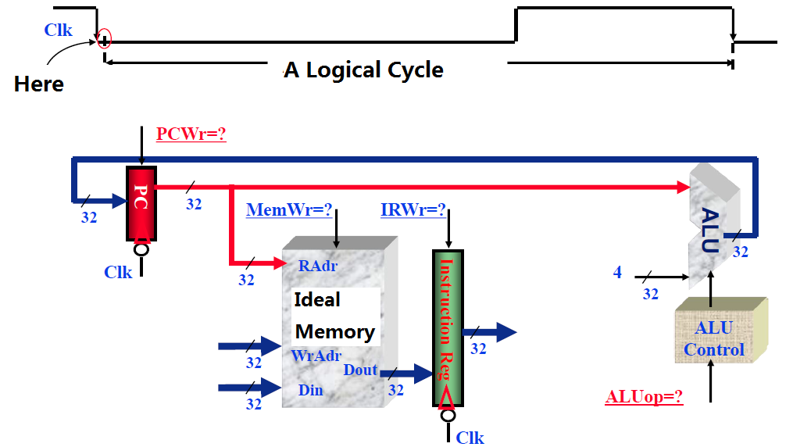
Beginning of Ins Fetch
4.2

Slide 28
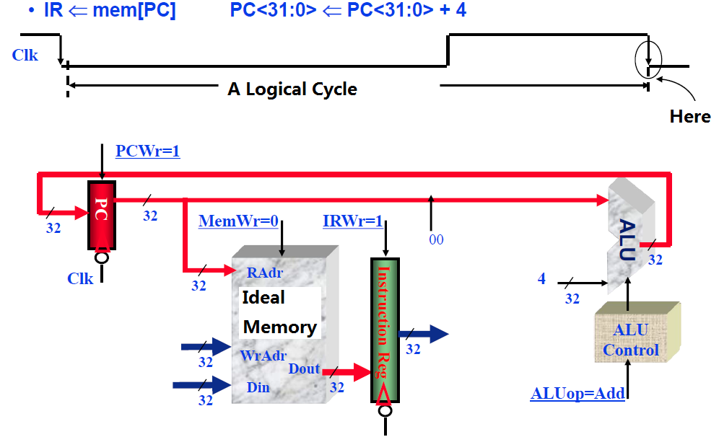
End of Ins Fetch
4.3

Slide 29
Ins Fetch Cycle
4.4

Slide 30
Fetch Registers and Ins Decode
4.5
busA<=RegFile[rs]; busB<=RegFile[rt]
ALU is not in use: ALUctr=XX

Slide 31
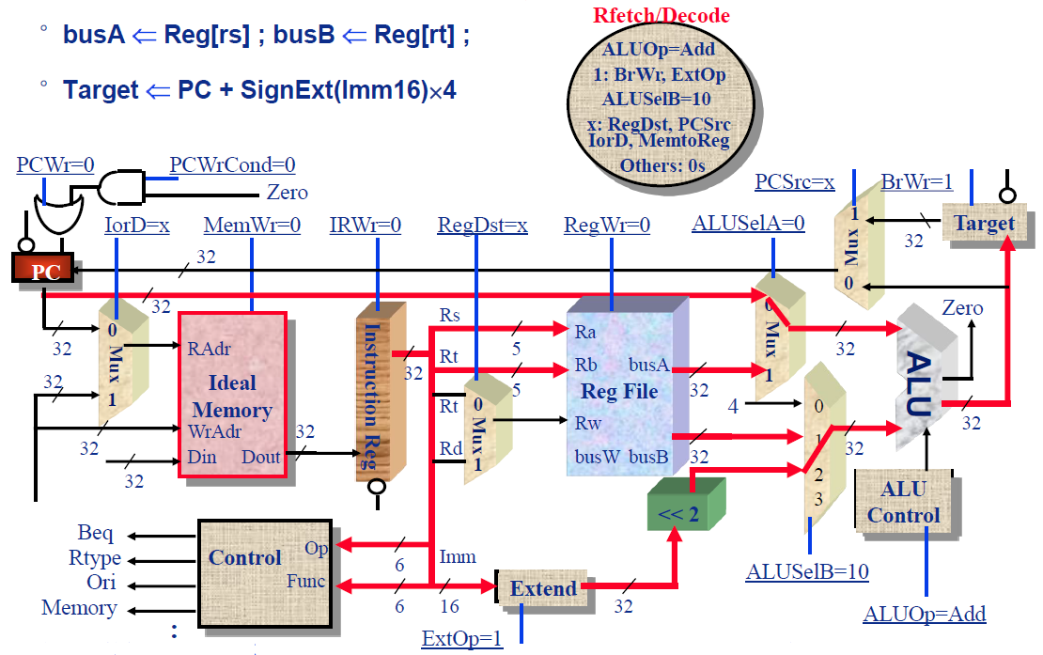
Fetch Registers and Ins Decode-Continued
4.5

Slide 32
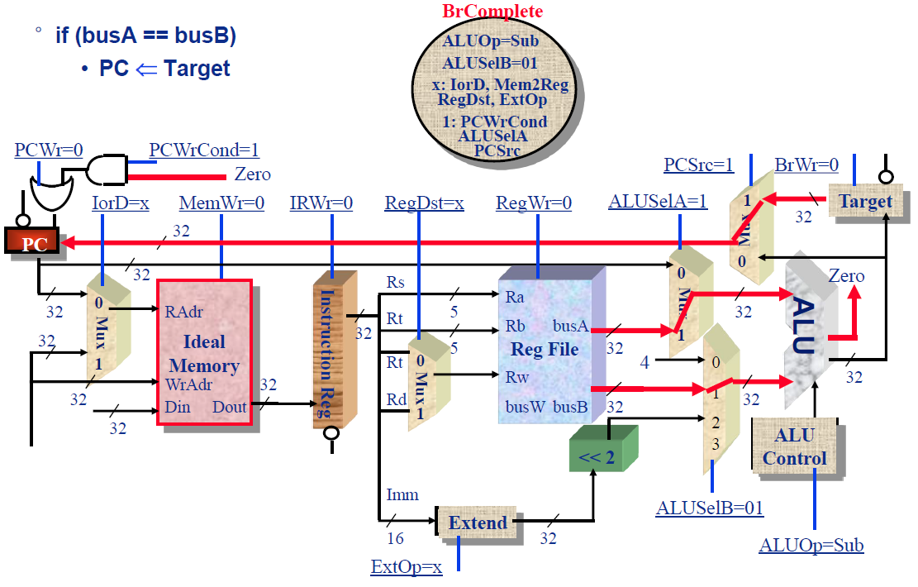
The end of branch instruction
4.6

Slide 33
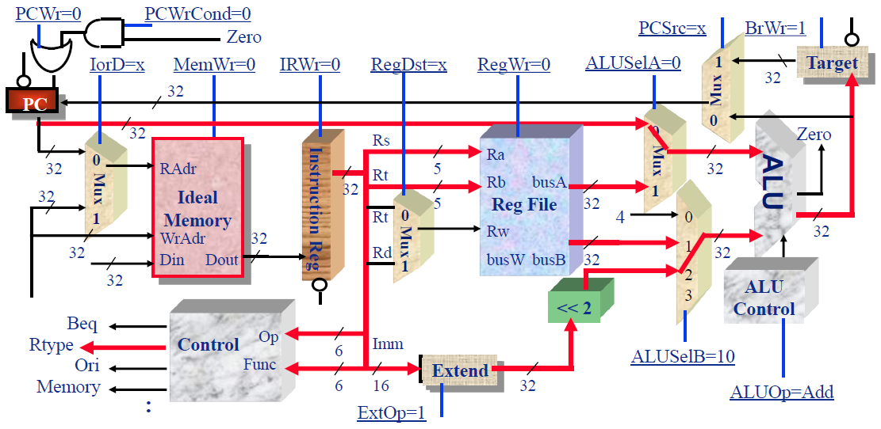
Instruction Decode: R-Type
4.7

Slide 34
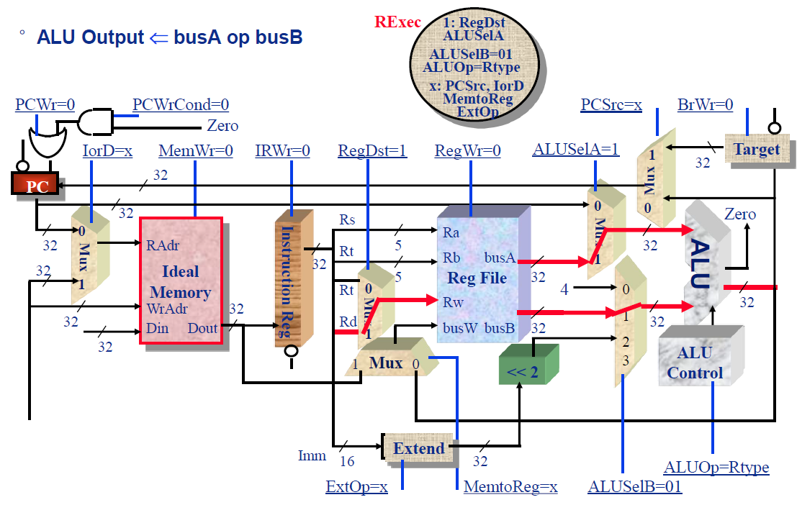
Execution of R-type
4.8

Slide 35
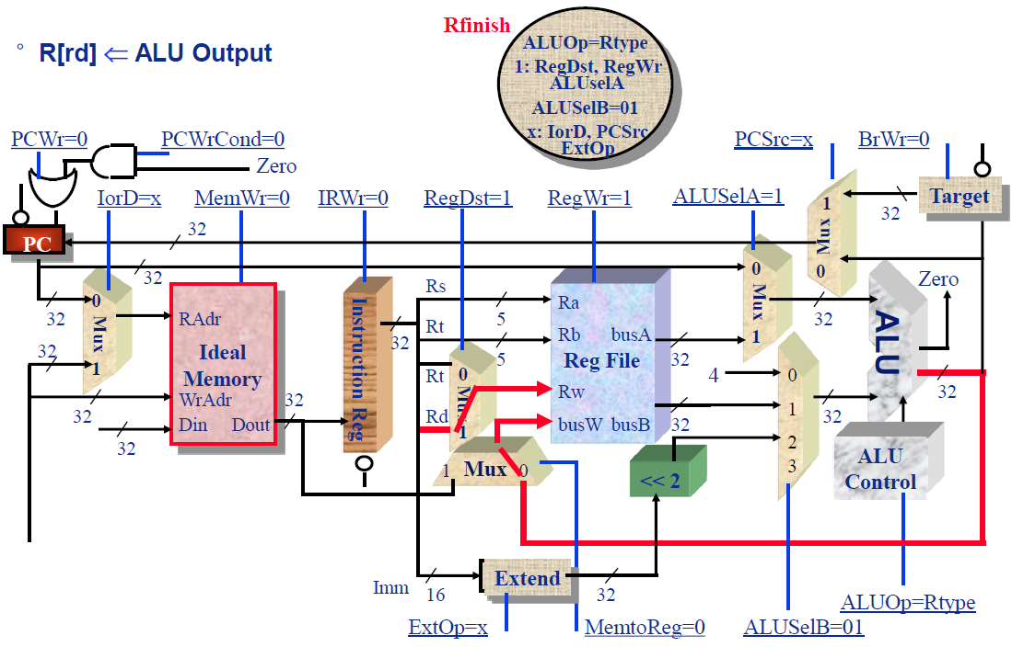
Finish of R-Type
4.9

Slide 36
Instruction Decode: Ori
4.10

Slide 37
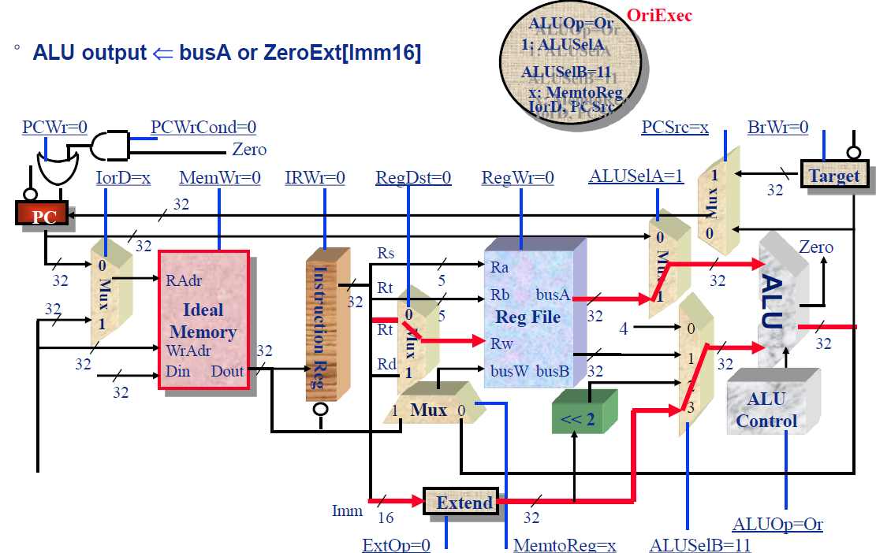
Execution of Ori
4.11

Slide 38
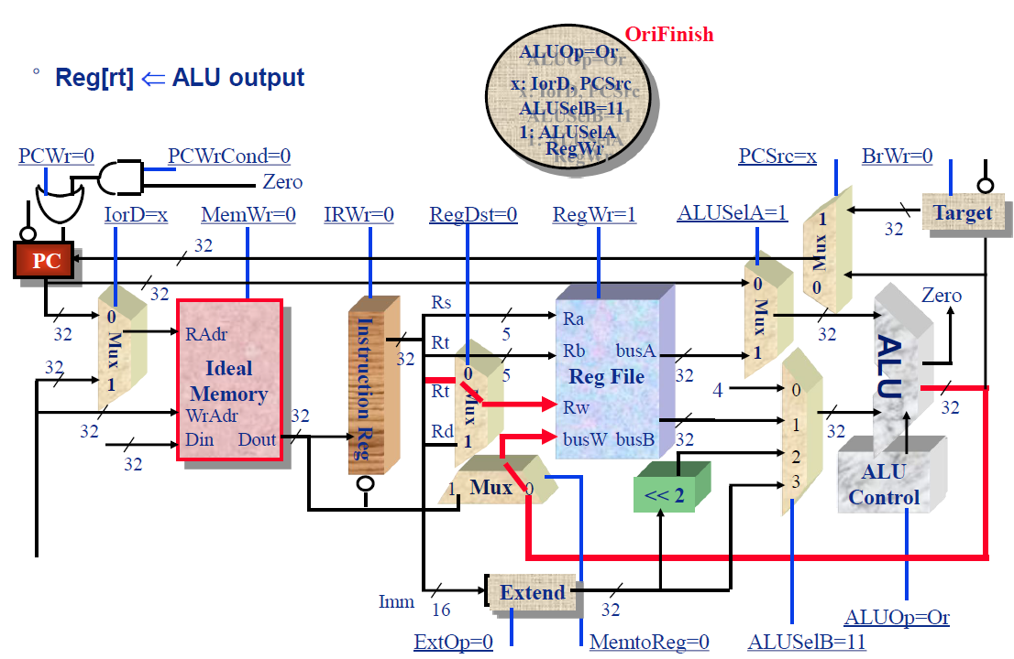
Finish of Ori
4.12

Slide 39
Instruction Decode: LW/SW
4.13

Slide 40
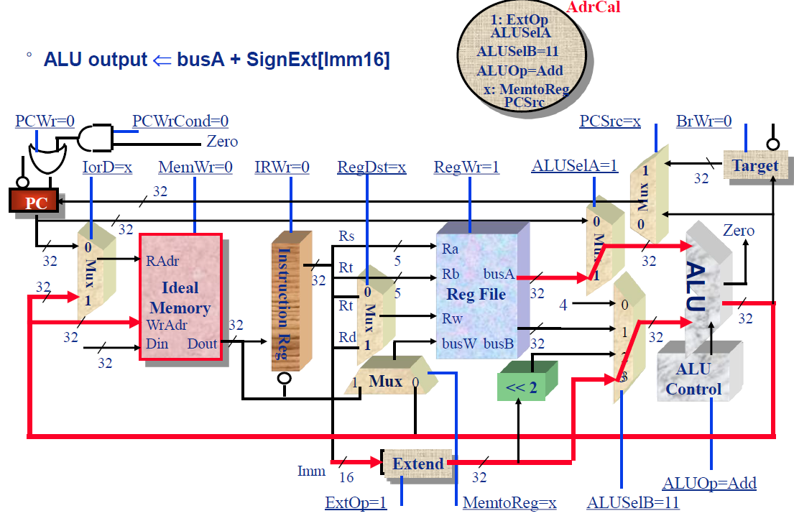
Memory Address Calculating
4.14

Slide 41
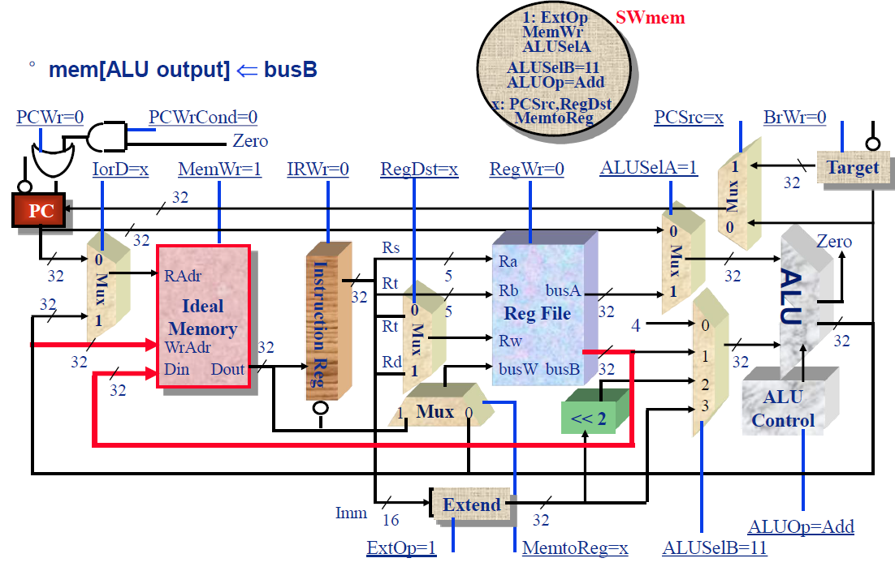
Memory Access for SW
4.15

Slide 42
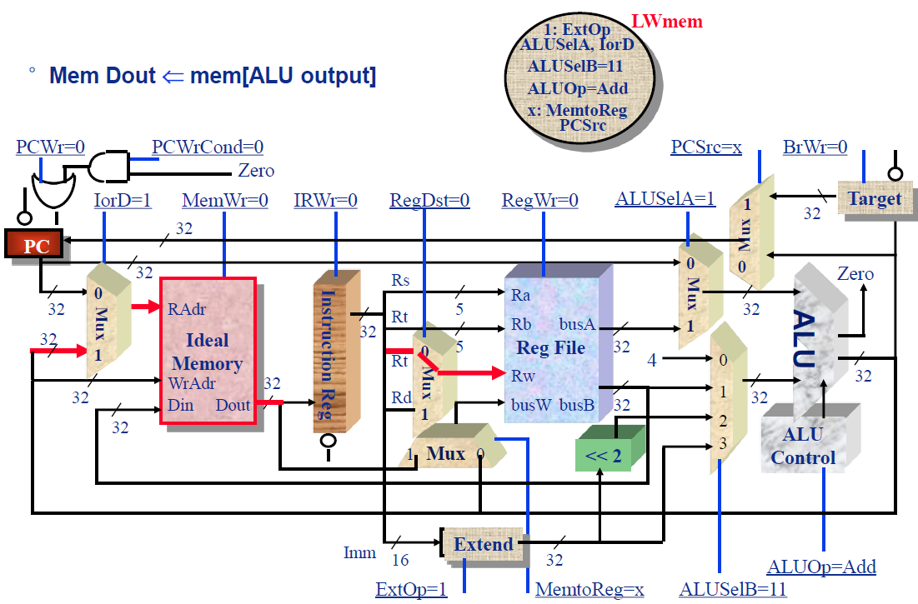
Memory Access for LW
4.16

Slide 43
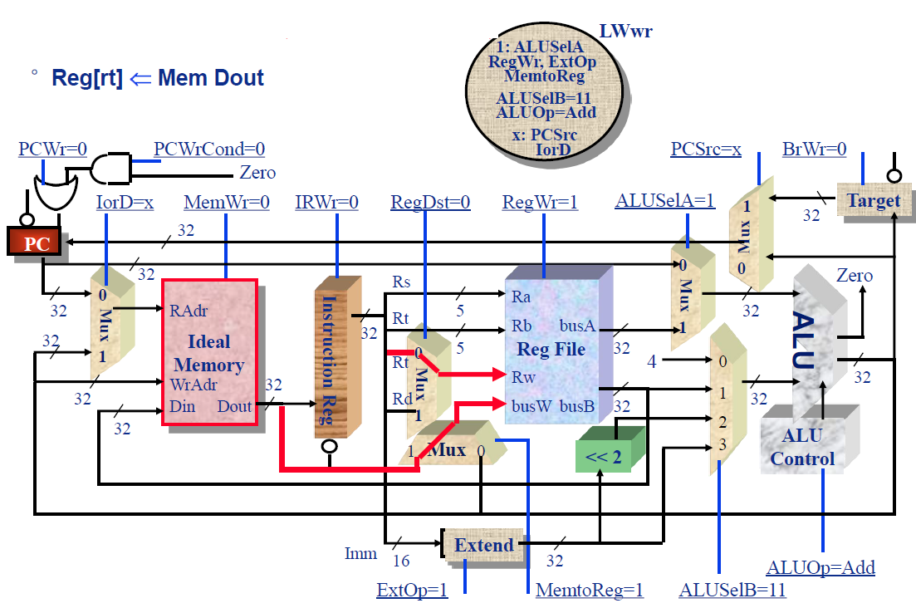
Write Back for LW
4.17

Slide 44
Recap:Multi-Cycle Datapath in Textbook
Minimum Hardware: A memory and an adder

Slide 45
Control FSM
4.18

Slide 46
Today’s Topic
00
01. Introduction & Recap
02. Analyze the Single Cycle Microprocessor
03. Construct a Multi-Cycle Datapath
04. More details of the Multi-Cycle Datapath
05. Control
06. Exceptions
07. Summary

Slide 47
Our Control Model
5.1
State specifies control points for Register Transfer
Transfer occurs upon exiting state (same falling edge)
inputs (conditions)
Next State
Logic
State X
Register Transfer
Control Points
Control State
Depends on Input
Output Logic
outputs (control points)

Slide 48
Step 4 ⇒ Control Specification for multicycle proc
5.2
IR <= MEM[PC]
“instruction fetch”
A <= R[rs]
B <= R[rt]
“decode / operand fetch”
R-type
ORi
LW
SW
BEQ
S <= A fun B
S <= A or ZX
S <= A + SX
S <= A + SX
PC <=
Next(PC,Equal)
Execute
M <= MEM[S]
MEM[S] <= B
PC <= PC + 4
Memory
R[rd] <= S
PC <= PC + 4
R[rt] <= S
PC <= PC + 4
R[rt] <= M
PC <= PC + 4
Write-back

Slide 49
Traditional FSM Controller
5.3
next
state
state
op
cond
control points
Truth Table
next
State
control points
11
Equal
6
4
State
op
datapath State

Slide 50
Step 5 ⇒ (datapath + state diagram ⇒ control)
5.4
Translate RTs into control points
Assign states
Then go build the controller

Slide 51
Mapping RTs to Control Points
5.5
IR <= MEM[PC]
“instruction fetch”
imem_rd, IRen
A <= R[rs]
B <= R[rt]
“decode”
Aen, Ben,
Een
R-type
ORi
LW
SW
BEQ
S <= A fun B
S <= A or ZX
S <= A + SX
S <= A + SX
PC <=
Next(PC,Equal)
ALUfun, Sen
Execute
M <= MEM[S]
MEM[S] <= B
PC <= PC + 4
Memory
R[rd] <= S
PC <= PC + 4
RegDst,
RegWr,
PCen
R[rt] <= S
PC <= PC + 4
R[rt] <= M
PC <= PC + 4
Write-back

Slide 52
Assigning States
5.6
IR <= MEM[PC]
“instruction fetch”
0000
A <= R[rs]
B <= R[rt]
“decode”
0001
R-type
ORi
LW
SW
BEQ
S <= A fun B
S <= A or ZX
S <= A + SX
S <= A + SX
PC <= Next(PC)
Execute
0100
0110
1000
1011
0011
M <= MEM[S]
MEM[S] <= B
PC <= PC + 4
Memory
1001
1100
R[rd] <= S
PC <= PC + 4
R[rt] <= S
PC <= PC + 4
R[rt] <= M
PC <= PC + 4
Write-back
0101
0111
1010

Slide 53
(Mostly) Detailed Control Specification (missing⇒0)
5.7
State Op field Eq Next IR PC Ops Exec Mem Write-Back
en sel A B E Ex Sr ALU S R W M M-R Wr Dst
0000 ?????? ? 0001 1
0001 BEQ x 0011 1 1 1
0001 R-type x 0100 1 1 1
0001 ORI x 0110 1 1 1
0001 LW x 1000 1 1 1
0001 SW x 1011 1 1 1
0011 xxxxxx 0 0000 1 0 x 0 x
0011 xxxxxx 1 0000 1 1 x 0 x
0100 xxxxxx x 0101 0 1 fun 1
0101 xxxxxx x 0000 1 0 0 1 1
0110 xxxxxx x 0111 0 0 or 1
0111 xxxxxx x 0000 1 0 0 1 0
1000 xxxxxx x 1001 1 0 add 1
1001 xxxxxx x 1010 1 0 1
1010 xxxxxx x 0000 1 0 1 1 0
1011 xxxxxx x 1100 1 0 add 1
1100 xxxxxx x 0000 1 0 0 1 0
-all same in Moore machine
BEQ:
R:
ORi:
LW:
SW:

Slide 54
Performance Evaluation
5.8
What is the average CPI?
state diagram gives CPI for each instruction type
workload gives frequency of each type
Type CPI_{i} for type Frequency CPI_{i} x freqI_{i}
Arith/Logic 4 40% 1.6
Load 5 30% 1.5
Store 4 10% 0.4
branch 3 20% 0.6
Average CPI: 4.1

Slide 55
How Effectively are we utilizing our hardware?
5.9
IR <- Mem[PC]
A <- R[rs]; B<– R[rt]
S <– A + B
S <– A or ZX
S <– A + SX
S <– A + SX
M <– Mem[S]
Mem[S] <- B
R[rd] <– S;
PC <– PC+4;
R[rt] <– S;
PC <– PC+4;
R[rd] <– M;
PC <– PC+4;
PC <– PC+4;
PC < PC+4;
PC < PC+SX;
Example: memory is used twice, at different times
Ave mem access per inst = 1 + Flw + Fsw ~ 1.3
if CPI is 4.8, imem utilization = 1/4.8, dmem =0.3/4.8
We could reduce HW without hurting performance
extra control

Slide 56
Today’s Topic
00
01. Introduction & Recap
02. Analyze the Single Cycle Microprocessor
03. Construct a Multi-Cycle Datapath
04. More details of the Multi-Cycle Datapath
05. Control
06. Exceptions
07. Summary

Slide 57
Exceptions
6
user program
System
Exception
Handler
Exception:
return from
exception
normal control flow:
sequential, jumps, branches, calls, returns
Exception = unprogrammed control transfer
system takes action to handle the exception
must record the address of the offending instruction
record any other information necessary to return afterwards
returns control to user
must save & restore user state
Allows constuction of a “user virtual machine”

Slide 58
Two Types of Exceptions: Interrupts and Traps
6.1
Interrupts
caused by external events:
Network, Keyboard, Disk I/O, Timer
asynchronous to program execution
Most interrupts can be disabled for brief periods of time
Some (like “Power Failing”) are non-maskable (NMI)
may be handled between instructions
simply suspend and resume user program
Traps
caused by internal events
exceptional conditions (overflow)
errors (parity)
faults (non-resident page)
synchronous to program execution
condition must be remedied by the handler
instruction may be retried or simulated and program continued or program may be aborted

Slide 59
Traps and Interrupts
6.2
exception means any unexpected change in control flow, without distinguishing internal or external;
Type of event From where? terminology I/O device request External Interrupt Invoke OS from user program Internal Trap Arithmetic overflow Internal Trap Using an undefined instruction Internal Trap Hardware malfunctions Either Trap or Interrupt

Slide 60
What happens to Instruction with Exception?
6.3
MIPS architecture defines the instruction as having no effect if the instruction causes an exception.
When we get to virtual memory we will see that certain classes of exceptions must prevent the instruction from changing the machine state.
This aspect of handling exceptions becomes complex and potentially limits performance => why it is hard

Slide 61
Precise Interrupts
6.4
Precise ⇒ state of the machine is preserved as if program executed up to the offending instruction
All previous instructions completed
Offending instruction and all following instructions act as if they have not even started
Same system code will work on different implementations
Difficult in the presence of pipelining, out-ot-order execution, ...
MIPS takes this position
Imprecise ⇒ system software has to figure out what is where and put it all back together
Performance goals often lead designers to not implement precise interrupts
system software developers, user, markets etc. usually wish they had not done this
Modern techniques for out-of-order execution and branch prediction help implement precise interrupts

Slide 62
Big Picture: user / system modes
6.5
By providing two modes of execution (user/system) it is possible for the computer to manage itself
operating system is a special program that runs in the privileged mode and has access to all of the resources of the computer
presents “virtual resources” to each user that are more convenient that the physical resources
files vs. disk sectors
virtual memory vs physical memory
protects each user program from others
protects system from malicious users.
OS is assumed to “know best”, and is trusted code, so enter system mode on exception.
Exceptions allow the system to taken action in response to events that occur while user program is executing:
Might provide supplemental behavior (dealing with denormal floating-point numbers for instance).
“Unimplemented instruction” used to emulate instructions that were not included in hardware

Slide 63
Addressing the Exception Handler
6.6
Traditional Approach: Interupt Vector
PC <- MEM[ IV_base + cause || 00]
370, 68000, Vax, 80x86, . . .
RISC Handler Table
PC <– IT_base + cause || 0000
saves state and jumps
Sparc, PA, M88K, . . .
MIPS Approach: fixed entry
PC <– EXC_addr
Actually very small table
RESET entry
TLB
other
handler
code
iv_base
cause
handler entry code
iv_base
cause

Slide 64
Saving State
6.6
Push it onto the stack
68k, 80x86
Shadow Registers
M88k
Save state in a shadow of the internal pipeline registers
Save it in special registers
MIPS EPC, BadVaddr, Status, Cause

Slide 65
Additions to MIPS ISA to support Exceptions?
6.7
Exception state is kept in “coprocessor 0”.
Use mfc0 read contents of these registers
Every register is 32 bits, but may be only partially defined
BadVAddr (register 8)
register contains memory address at which memory reference occurred
Status (register 12)
interrupt mask and enable bits
Cause (register 13)
the cause of the exception
Bits 5 to 2 of this register encodes the exception type (e.g undefined instruction=10 and arithmetic overflow=12)
EPC (register 14)
address of the affected instruction (register 14 of coprocessor 0).
Control signals to write BadVAddr, Status, Cause, and EPC
Be able to write exception address into PC (8000 0080_{hex})
May have to undo PC = PC + 4, since want EPC to point to offending instruction (not its successor): PC = PC - 4

Slide 66
Details of Status register
6.7
15
8
5
4
3
2
1
0
Status
Mask
k
e
k
e
k
e
old
prev
current
Mask = 1 bit for each of 5 hardware and 3 software interrupt levels
1 => enables interrupts
0 => disables interrupts
k = kernel/user
0 => was in the kernel when interrupt occurred
1 => was running user mode
e = interrupt enable
0 => interrupts were disabled
1 => interrupts were enabled
When interrupt occurs, 6 LSB shifted left 2 bits, setting 2 LSB to 0
run in kernel mode with interrupts disabled

Slide 67
Details of Cause register
6.7
15
10
5
2
Status
Pending
Code
Pending interrupt 5 hardware levels: bit set if interrupt occurs but not yet serviced
handles cases when more than one interrupt occurs at same time, or while records interrupt requests when interrupts disabled
Exception Code encodes reasons for interrupt
0 (INT) => external interrupt
4 (ADDRL) => address error exception (load or instr fetch)
5 (ADDRS) => address error exception (store)
6 (IBUS) => bus error on instruction fetch
7 (DBUS) => bus error on data fetch
8 (Syscall) => Syscall exception
9 (BKPT) => Breakpoint exception
10 (RI) => Reserved Instruction exception
12 (OVF) => Arithmetic overflow exception

Slide 68
Example: How Control Handles Traps in our FSD
6.8
Undefined Instruction–detected when no next state is defined from state 1 for the op value.
We handle this exception by defining the next state value for all op values other than lw, sw, 0 (R-type), jmp, beq, and ori as new state 12.
Shown symbolically using “other” to indicate that the op field does not match any of the opcodes that label arcs out of state 1.
Arithmetic overflow–detected on ALU ops such as signed add
Used to save PC and enter exception handler
External Interrupt – flagged by asserted interrupt line
Again, must save PC and enter exception handler
Note: Challenge in designing control of a real machine is to handle different interactions between instructions and other exception-causing events such that control logic remains small and fast.
Complex interactions makes the control unit the most challenging aspect of hardware design

Slide 69
How to add traps and interrupts to state diagram
6.9
“instruction fetch”
IR <= MEM[PC]
PC <= PC + 4
Pending INT
EPC <= PC - 4
PC <= exp_addr
cause <= 0(INT)
0000
“decode”
EPC <= PC - 4
PC <= exp_addr
cause <= 12 (Ovf)
Handle
Interrupt
S<= PC +SX
EPC <= PC - 4
PC <= exp_addr
cause <= 10 (RI)
0001
other
R-type
ORi
LW
BEQ
overflow
SW
undefined
instruction
If A = B
then PC <= S
S <= A - B
S <= A fun B
S <= A op ZX
S <= A + SX
S <= A + SX
0100
0110
1000
1011
0010
M <= MEM[S]
MEM[S] <= B
1001
1100
R[rd] <= S
R[rt] <= S
R[rt] <= M
0101
0111
1010

Slide 70
Summary
7
Disadvantages of the Single Cycle Processor
Long cycle time
Cycle time is too long for all instructions except the Load
Multiple Cycle Processor:
Divide the instructions into smaller steps
Execute each step (instead of the entire instruction) in one cycle
Partition datapath into equal size chunks to minimize cycle time
~10 levels of logic between latches
Follow same 5-step method for designing “real” processor

